Slide 1

Lecture
on
“Advanced Computer Architecture –TCS 704”
by
Akansha Gupta
DEPARTMENT OF COMPUTER SCIENCE AND ENGINEERING
GRAPHIC ERA DEEMED TO BE UNIVERSITY – 248002

Slide 2
Advanced Cache Optimization

Slide 3
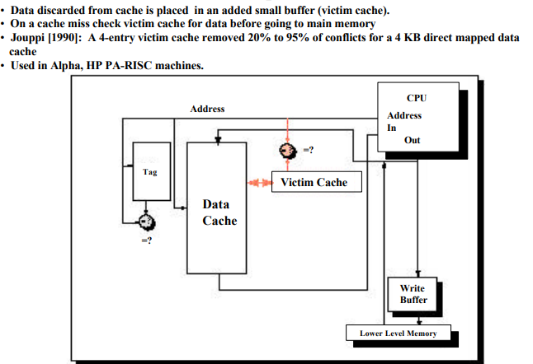
Victim Caches

Slide 4
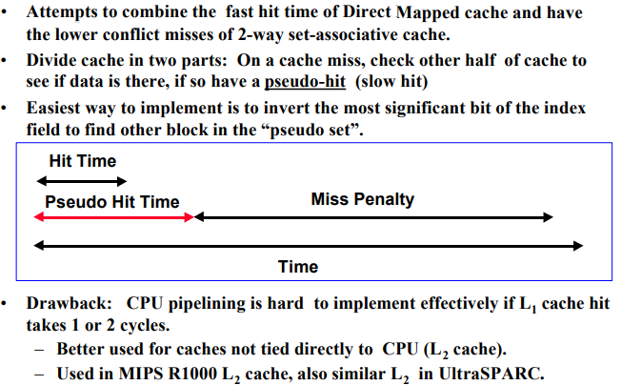
Pseudo-Associative Cache

Slide 5
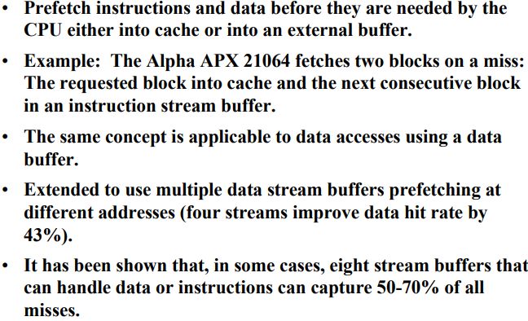
Hardware Prefetching of Instructions And Data

Slide 6
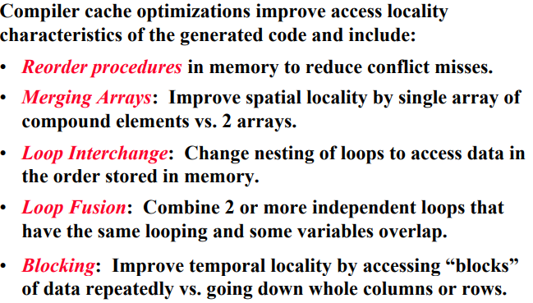
Compiler Optimizations

Slide 7
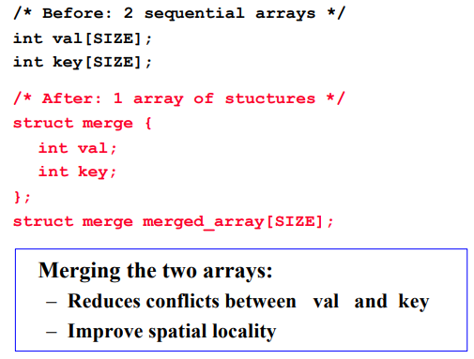
Merging Arrays Example

Slide 8
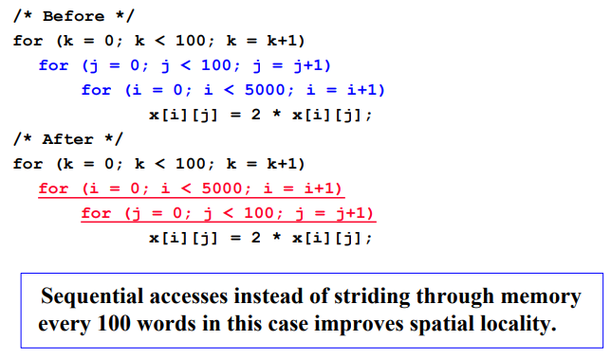
Loop Interchange Example

Slide 9
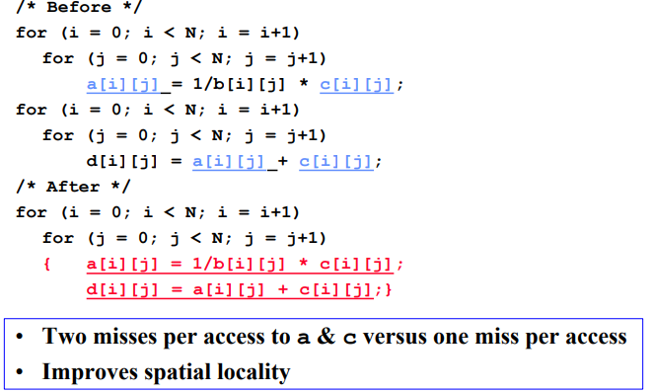
Loop Fusion Example

Slide 10
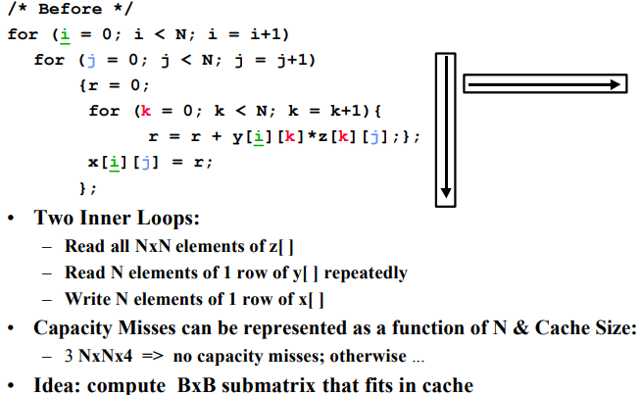
Data Access Blocking Example

Slide 11
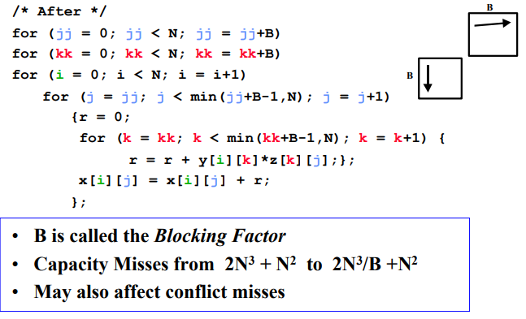
Blocking Example (continued)

Slide 12
https://youtu.be/ka3byYqFKa8
THANKS

